Slide 1
Chapter 4 Professional Ethics

Slide 2
Profession

Slide 3
Job and Occupation
Job: a piece of work, especially a specific task done as part of the routine of one's occupation or for an agreed price. anything a person is expected or obliged to do; duty; responsibility
Occupation: a person's usual or principal work or business, especially as a means of earning a living
a job or profession
Profess
To declare or admit openly
To declare in words or APPEARANCE
Profession
An act of openly declaring or publicly claiming a belief, faith, or opinion

Slide 4
Characteristics of Profession
Essential Social Function
Recognition by society
Recognition by employers
Recognition by members
Specialized body of knowledge
Formal education
Conceptual rather than practical
Requirements for admission
Demonstration of technical competence
Hurdle for monopoly rights
Usually requires examination and experience
Licensing often required
Self-regulated
Code of Ethics
Concern for “interests of society”
Procedures for discipline
adaptability
Continuing professional education
Awareness of changing social conditions
Significance of broad “liberal education”

Slide 5
Engineering and Computing as profession
Software engineers
Network engineers
Hardware engineers
System engineer
Developers
Testers
QAs
Researchers

Slide 6
Need for professional ethics
Responsibility to serve the public
Complex body of knowledge
Standards of Admission to the Profession
Need for public confidence

Slide 7
Code of Professional Conduct
Designed to provide a framework for expanding professional services and responding to changes in the profession
Two sections
Principles
Rules
Additional guidance
Interpretations
Ethics Rulings

Slide 8
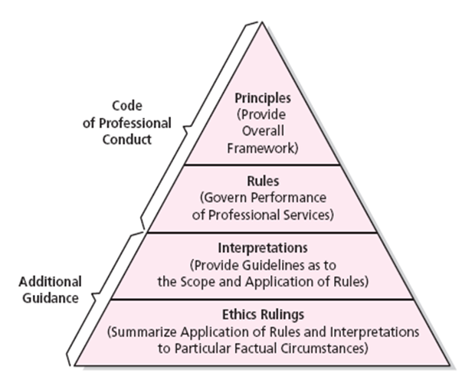
Professional Ethics

Slide 9
Professional Responsibilities and Rights

Slide 10
Conflict of interests and whistle blowing
A conflict of interest is anything that impedes or might be perceived to impede an individual's or firm's ability to act impartially and in the best interest of a client.
A conflict of interest can cast doubt on your integrity; it can also have a damaging effect on your firm and the profession as a whole.

Slide 11
Conflict of interest
Causes of conflict of interest
How might judgment be swayed … any interest, influence, loyalty, concern, emotion, or other feature tending to make judgment less reliable than normal.
Self-interest - bribes, kickback, gifts, free travel, favors, special advantages or treatment, dealings with family, relatives or relations
Fraud - misappropriation of funds or property
Misunderstanding - confused signals or incentives, boss/ everybody’s doing it, cultural differences, slippery slope

Slide 12
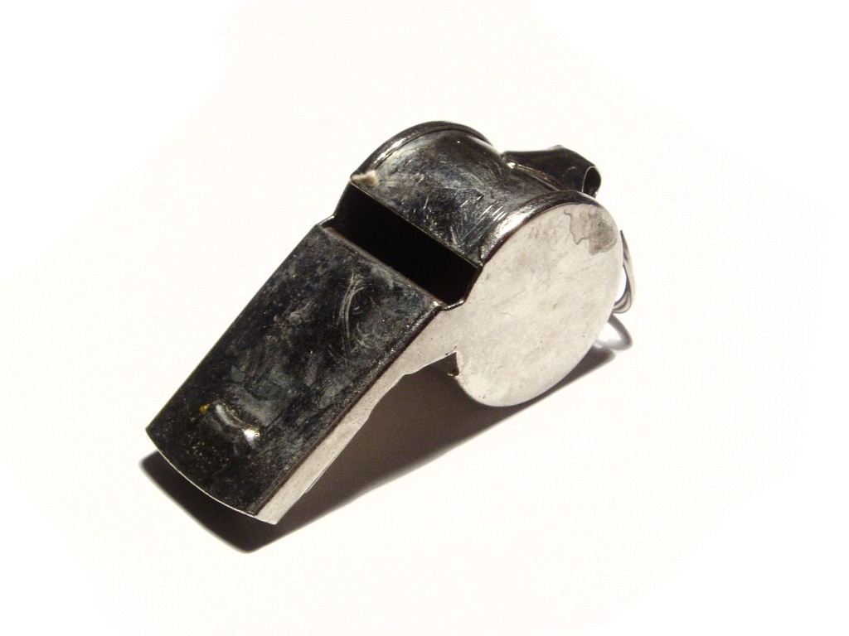
Whistle blowing

Slide 13
Whistle blowing
Whistleblowing is the situation, when employee, former employee, or member of an organization reports misconduct to people that have the power and presumed willingness to take corrective action
Internal whistleblowing (superiors)
External whistleblowing (broader public)

Slide 14
Whistle blowing
Whistleblower – an insider (trust, loyalty)
Whistleblowing – not selfish (for example, to save one’s own skin)
Organisation as a whole – useful and not criminal
To squeel on one’s own criminal gang is not whistleblowing
Aim – to improve the organisation, not to destroy it

Slide 15
Professional Code of Ethics

Slide 16
Code of Ethics of Nepal Engineering Council
Discipline and honesty
Politeness and secrecy
Non-discrimination
Limit service in concerned expertise
Abstain from work which harm engineering profession
Professional responsibility
State name, designation and registration number
No publicity and advertisement

Slide 17
Code of Ethics of IEEE
to accept responsibility in making decisions consistent with the safety, health, and welfare of the public, and to disclose promptly factors that might endanger the public or the environment;
to avoid real or perceived conflicts of interest whenever possible, and to disclose them to affected parties when they do exist;
to be honest and realistic in stating claims or estimates based on available data;
to reject bribery in all its forms;
to improve the understanding of technology; its appropriate application, and potential consequences;
to maintain and improve our technical competence and to undertake technological tasks for others only if qualified by training or experience, or after full disclosure of pertinent limitations;
to seek, accept, and offer honest criticism of technical work, to acknowledge and correct errors, and to credit properly the contributions of others;
to treat fairly all persons and to not engage in acts of discrimination based on race, religion, gender, disability, age, national origin, sexual orientation, gender identity, or gender expression;
to avoid injuring others, their property, reputation, or employment by false or malicious action;
to assist colleagues and co-workers in their professional development and to support them in following this code of ethics.

Slide 18
Code of Ethics of ACM (Association for computer Machinery)
Strive to achieve the highest quality, effectiveness and dignity in both the process and products of professional work.
Acquire and maintain professional competence.
Know and respect existing laws pertaining to professional work.
Accept and provide appropriate professional review.
Give comprehensive and thorough evaluations of computer systems and their impacts, including analysis of possible risks.
Honor contracts, agreements, and assigned responsibilities.
Improve public understanding of computing and its consequences.
Access computing and communication resources only when authorized to do so.

Slide 19
Hacker Ethics and Netiquette

Slide 20
Hacker Ethics
Freedom of Information
The web is not physical; it couldn’t be interpreted as property, so it can be accessed by the public
Security/Privacy
Hackers do not want a real-life Big Brother society During the 80s, they discovered a major flaw in a credit firm, where the general public did not know that the firm was collecting their information

Slide 21
Do hackers have ethics?
Hackers maintain a trust system; the subculture operates in a tight network
Hackers are not entirely good, nor are they just as bad.
Intentions are based on utilitarianism

Slide 22
Netiquette
A third category of behavior on the Internet has to do with informal conventions that promote effective or civil or pleasant interaction online
This type of behavior is often referred to as netiquette.
Netiquette can be defined as "the dos and don'ts of online communication"
Information on netiquette on the Internet include, Information about how to behave when it comes to: bandwidth; e-mail, chat rooms; international interaction; and, virus alerts, etc.

Slide 23
Netiquette
Dark Mountain's Netiquette Guide lists three simple rules: be polite, be patient, and don't break any laws
Both flaming and spamming cases are violations of netiquette
A flame is an inflammatory or insulting message sent via e-mail or in other forms of online communication such as chat rooms
Spam, is unsolicited bulk email. It is the e-mail equivalent of junk mail

